Slide 1
Firm-Specific Knowledge Resources and Competitive Advantage: The Roles of Economic and Relationship-Based Employee Governance Mechanisms
Heli Wang, Jinyu He, Joseph T. Mahoney (2009)
Strategic Management Journal

Slide 2
Introduction
Hypotheses
Data and Methods
Results
Discussion
Resource-Based View
Firm-specific knowledge has the greatest potential to serve as a source of sustainable competitive advantage.
To achieve superior economic performance a firm usually requires its key employees to make firm-specific human capital investments.
The employees’ firm-specific human capital is imperfectly redeployable or is valued less in the external labor market than within the firm.
Key employees with foresight might be reluctant to make such firm-specific investments that would place them in a weak bargaining position.

Slide 3
Introduction
Hypotheses
Data and Methods
Results
Discussion
Research Question
Two general types of employee governance mechanisms that might mitigate employees’ reluctance to make firm-specific human capital investments
Economic-based governance mechanism
Secure employees’ economic gains against ex post value appropriation
Relationship-based mechanism
Foster trust between the firm and its employees

Slide 4
Introduction
Hypotheses
Data and Methods
Results
Discussion
Economic-based governance mechanism: Employee Stock Ownership
Employee stock ownership provides both a measure of residual control and a vehicle for profit-sharing to encourage productive effort.
Granting key employees such ownership rights directly is costly to the firm.
Firms use extra caution when considering adopting such policies, unless employee concern for firm opportunistic behavior is severe and the employee underinvestment problem is critical.
H1: Everything else equal, a firm’s level of firm-specific knowledge resources is positively associated with its use of employee stock ownership as a governance mechanism.

Slide 5
Introduction
Hypotheses
Data and Methods
Results
Discussion
Relationship-based governance mechanism: Firm-Employee Relationships
The employees may be more willing to commit if the firm shows its trustworthiness through practices that can help build its reputation as a fair and caring employer.
The development and maintenance of relational governance are costly because they often require substantial long-term investment by the firm in various human resource practices.
H2: Everything else equal, a firm’s level of firm-specific knowledge resources is positively associated with the extent to which it places emphasis on establishing good relationships with its key employees.

Slide 6
Introduction
Hypotheses
Data and Methods
Results
Discussion
Employee governance and performance advantage based on firm-specific knowledge
A firm’s governance system might be considered analogous to a valve, the inappropriate functioning of which will hinder the flow of firm-specific knowledge resources toward full realization of economic rents.
H3: Everything else equal, the relationship between the level of firm-specific knowledge resources and firm-level economic performance is positively moderated by employee stock ownership/firm-employee relationships.
The shirking or free-rider problem often occurs when the value distribution is not fine-tuned to individual performance. Such a problem can be especially severe in large firms or teams.
H4: The moderating role of employee stock ownership in the relationship between the level of firm-specific knowledge resources and firm-level economic performance will be weaker in larger firms.

Slide 7
Introduction
Hypotheses
Data and Methods
Results
Discussion
Sample
211 firms in manufacturing industries and 1,329 firm-year observations between 1994 and 2002
Measures
Firm economic performance – Tobin’s Q
Firm-specificity of knowledge resources (FS) – Number of self-citations
Firm-employee relationships – Net score from the ‘employee relations’ dimension
Employee stock ownership – % of ownership of common stock held by employees (EDGAR)

Slide 8
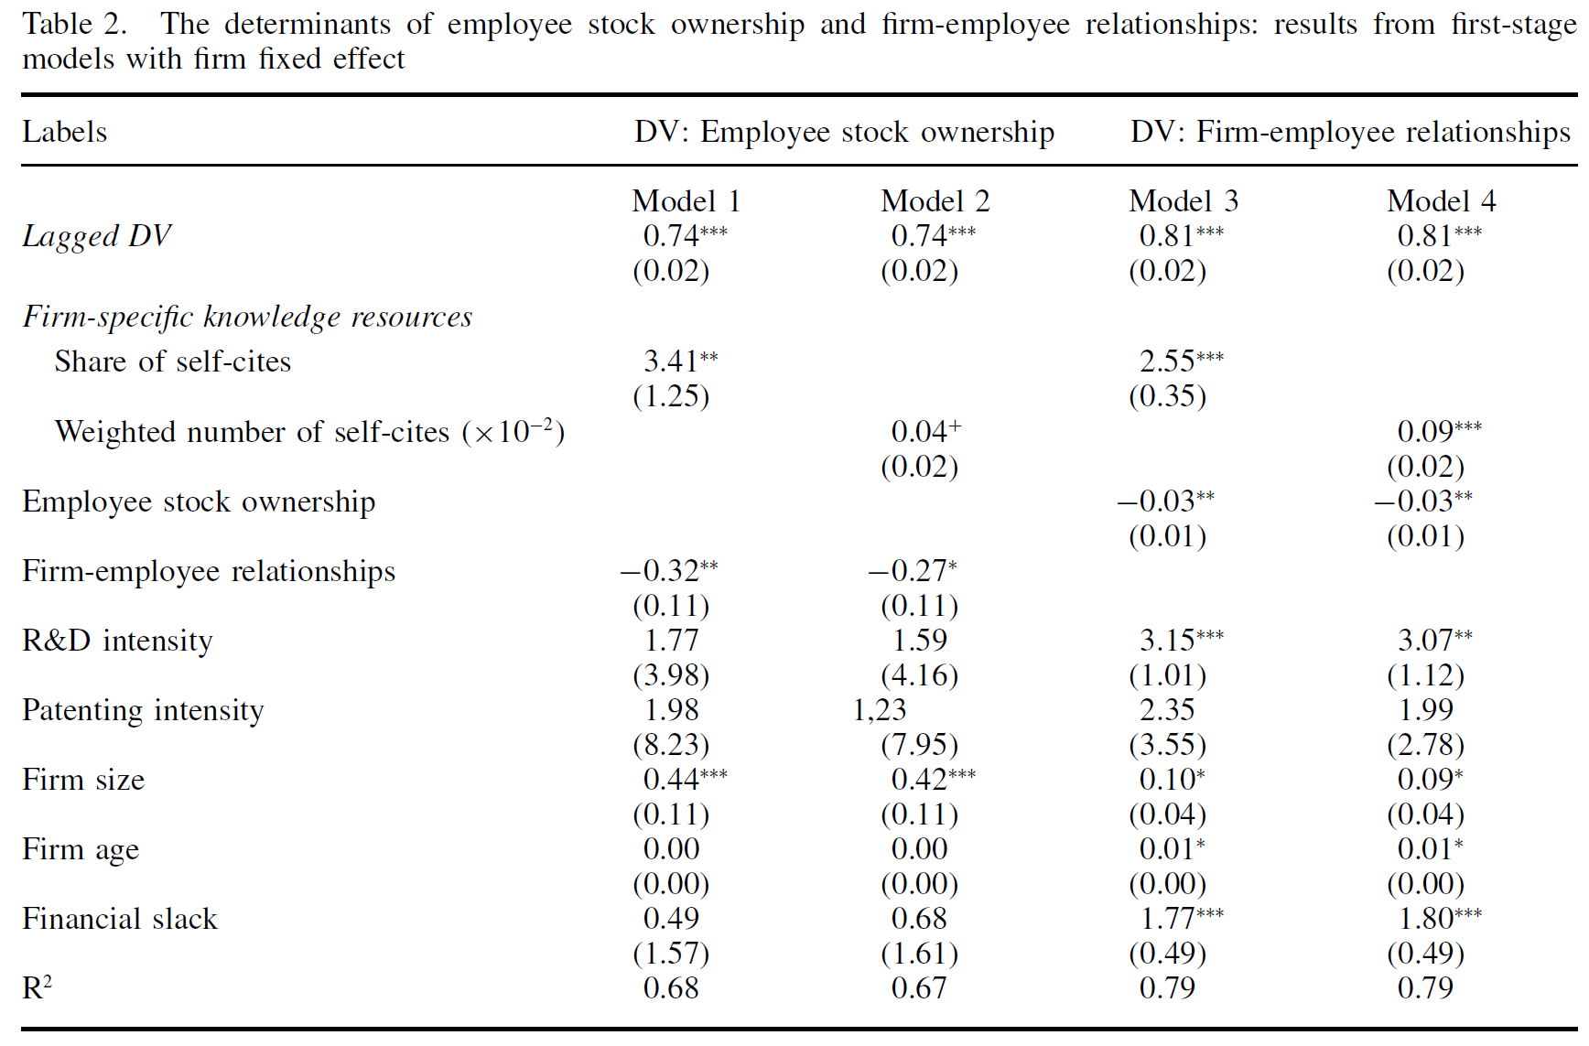
Introduction
Hypotheses
Data and Methods
Results
Discussion
First stage model:
Level of firm-specific knowledge resources
⬇
Degree of employee stock ownership
Cultivation of good firm-employee relationships
H1
H2

Slide 9
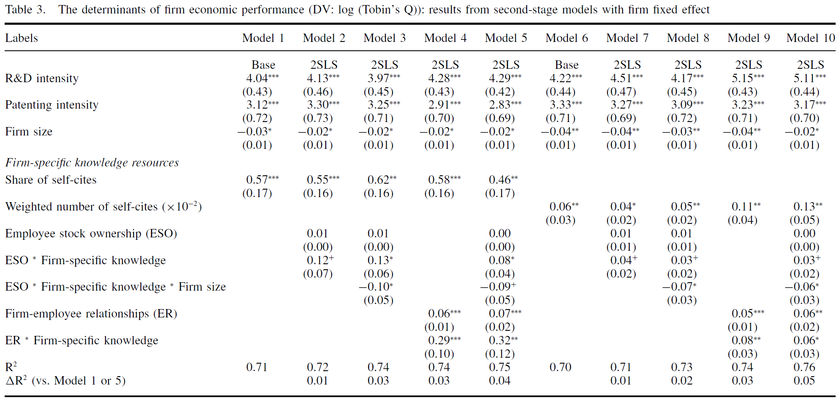
Introduction
Hypotheses
Data and Methods
Results
Discussion
Second stage model:
Level of firm-specific knowledge resources
⬇
Firm performance
Moderated by:
Employee stock ownership
Firm employee relationships
H1
H2
H3a
H4
H3b

Slide 10
Introduction
Hypotheses
Data and Methods
Results
Discussion
Conclusions
Firms with greater firm-specific knowledge resources are more likely to adopt governance mechanisms appropriate for reducing key employees’ concerns about holdup by the firm.
The increased use of these governance mechanisms strengthens the relationship between the level of firm-specific knowledge and a firm’s economic performance.
Contributions
Employee governance mechanisms are endogenous to the nature of firm knowledge resources.
A firm’s resource base and the effectiveness of its governance mechanisms jointly influence its economic profitability.
First systematic empirical test of these arguments.

